Slide 1
Stacks and Queues
A stack is a data structure that supports inserting and deleting data, with a special property (LIFO): the Last item In is the First item Out
Insert: push onto the stack
Delete: pop from the stack
A queue is a data structure that supports inserting and deleting data, with a special property (FIFO): the First item In is the First item Out
Insert: enqueue
Delete: dequeue
Fast implementations:
Stack: LinkedList1 will have O(1) worst-case performance
Queue: LinkedList2 will have O(1) worst-case performance

Slide 2
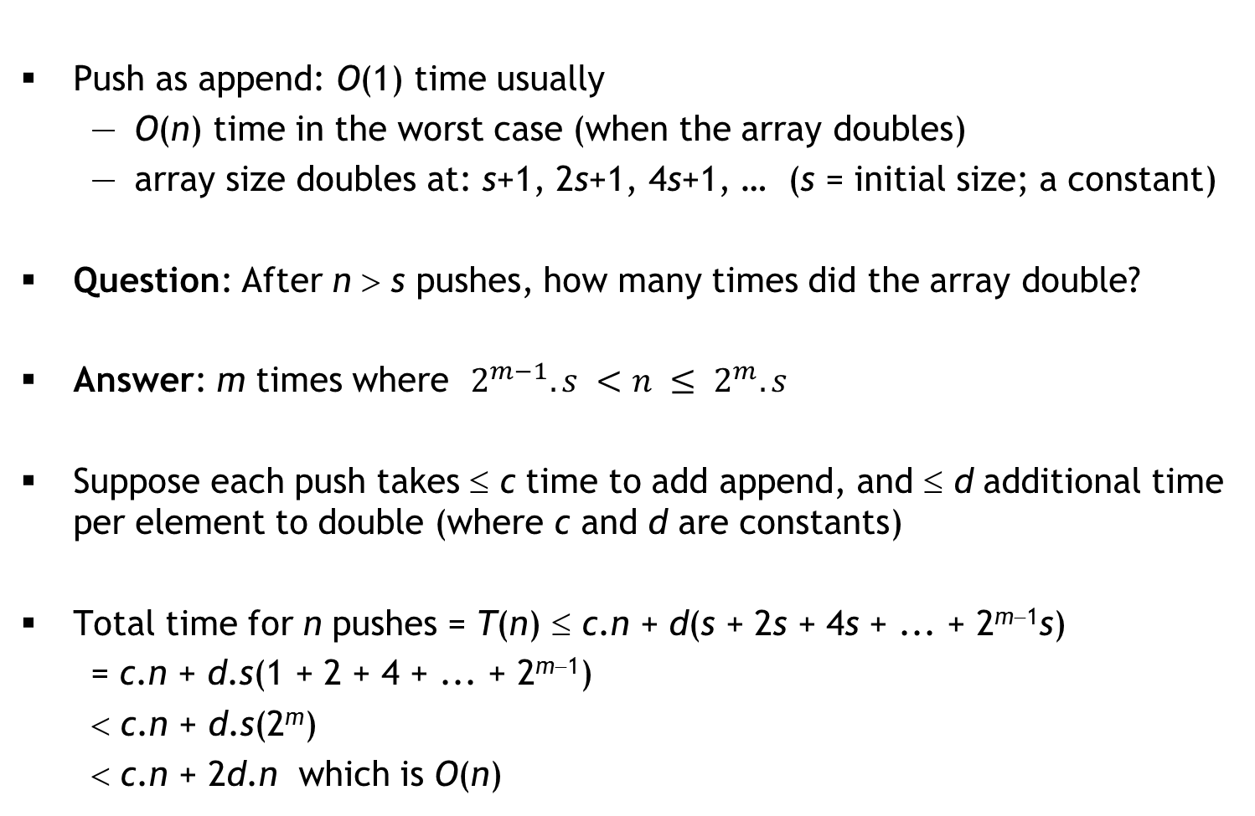
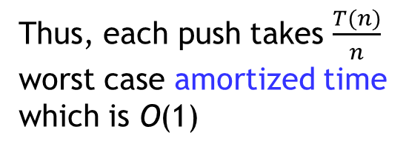
ArrayList2 implementation of Stack

Slide 3
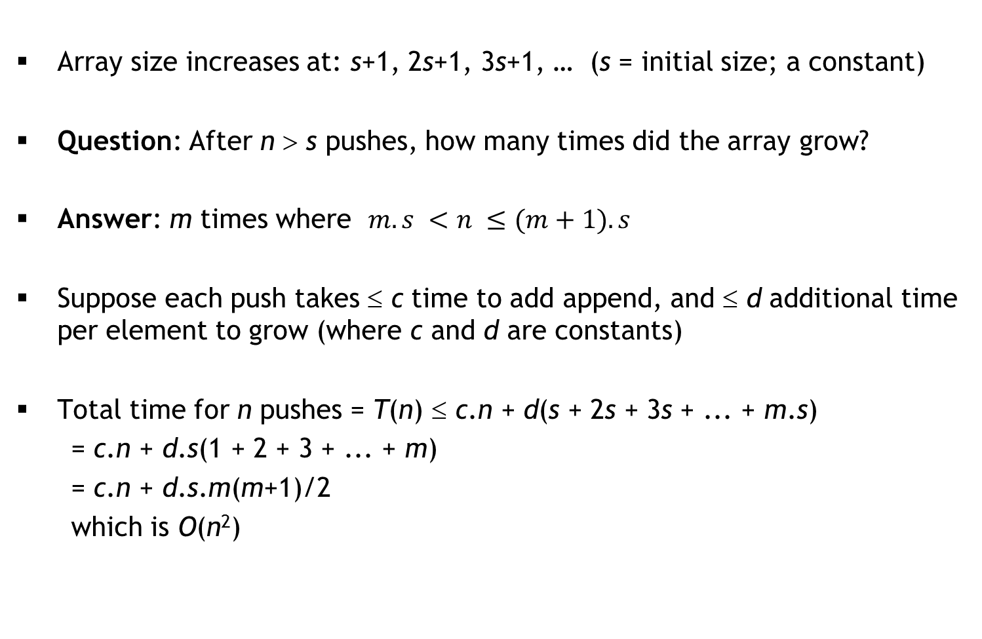

ArrayList2: growing by constant instead of doubling

Slide 4
Interview Questions
Standard ones:
Given two sorted queues Q1 and Q2, create a new sorted queue containing the elements of Q1 and Q2 in sorted order
Given a Stack implementation, implement a Queue
Given a Queue implementation, implement a Stack
Given a linked list of unknown length, determine whether the last element points to NULL, or links back to some earlier node
Dr. Ram’s question: What data structure will you use for Sudoku?
My question: We want to maintain a growing list of integers and support “find” and “insert” operations. For “find”, the data structure must have excellent worst-case performance, but “insert” can be occasionally expensive so long as the amortized time is good.
Idea: Maintain two ArrayLists: Sorted (large) and Unsorted (small). New data is appended to Unsorted in O(1) time, and find searches for data in Sorted using binary search and Unsorted using linear search. When Unsorted gets large, sort Unsorted and merge with Sorted.

